Slide 1

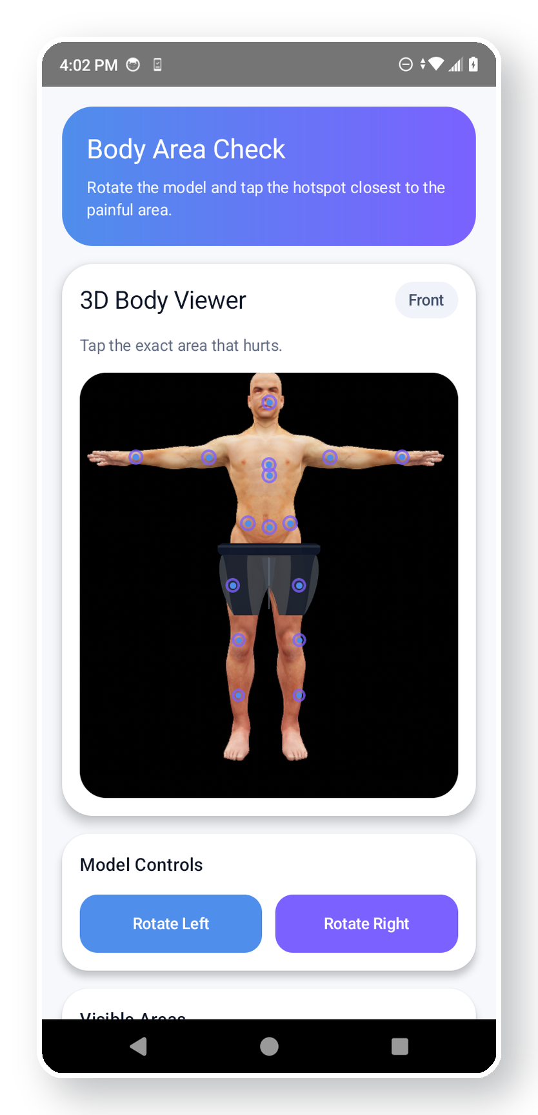
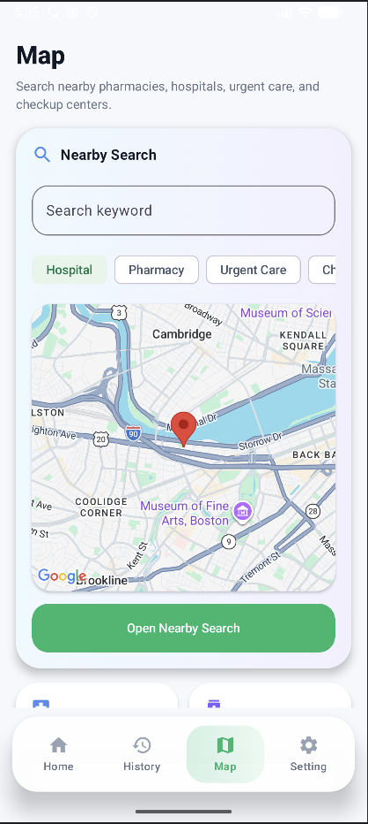
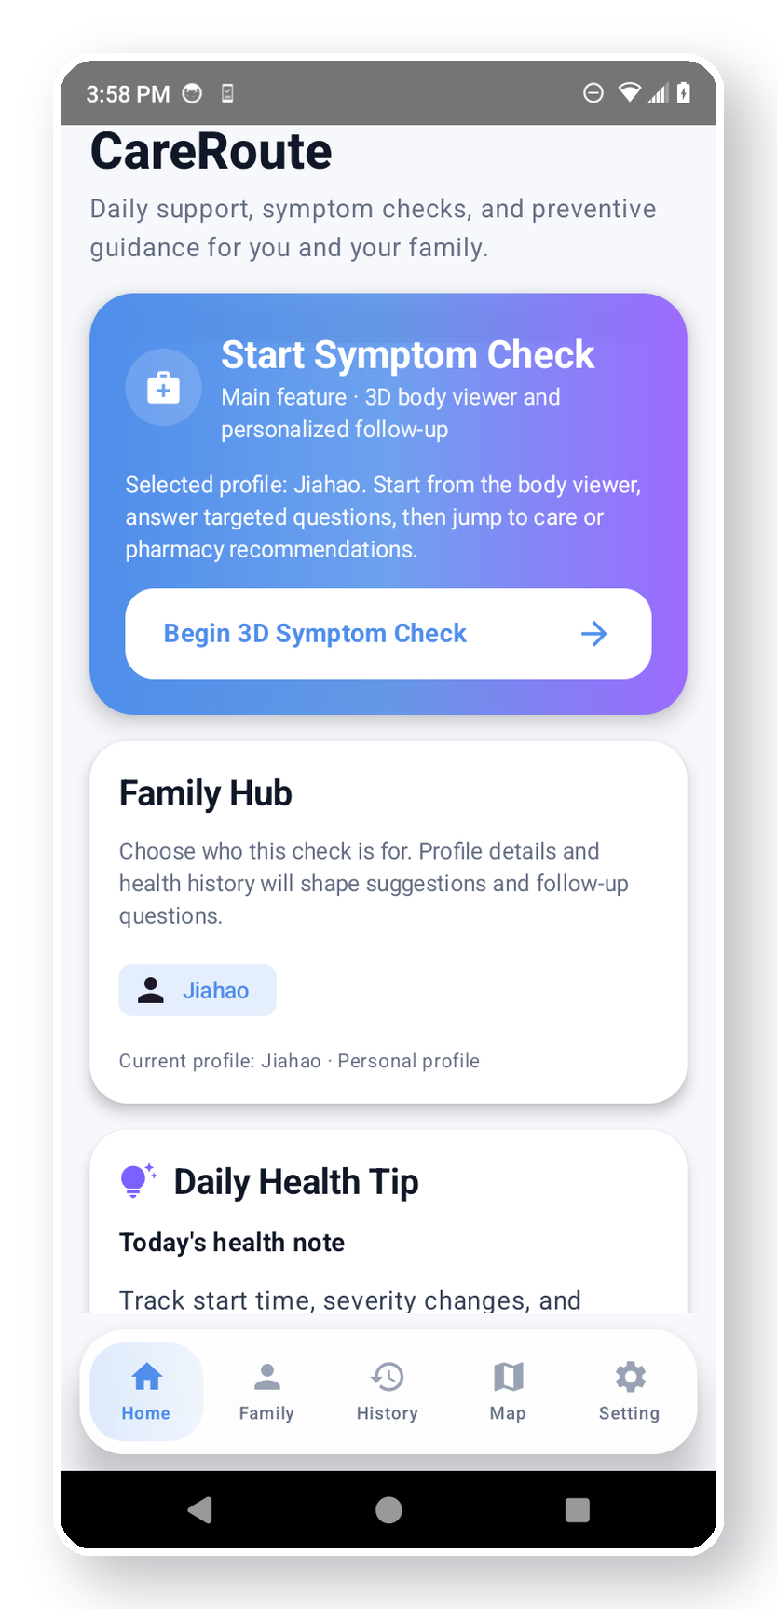
CareRoute
Update 2
Architecture · Testing · GitHub Updates · AI Usage
Kotlin + Jetpack Compose · MVVM · Room/DataStore · Firebase · Gemini · Google Maps
CS501 Final Project Update 2
Zhi Gao · Jiahao Hu · Wenhao Wang
Home
3D Body
Map
• Symptom support, not medical diagnosis
• Saved history for future visits
• Nearby care search connected to assessment
CareRoute · CS501
title
01

Slide 2
Table of Content
1
Architecture diagram
2
Debugging & testing
3
Team workflow
MVVM layers, flows, dependencies, database schemas, and navigation graph.
Build checks, emulator/manual paths, API fallback checks, database and permission tests.
Clear ownership from GitHub history and integration handoffs.
4
GitHub repository updates
5
AI usage statement
README/docs structure, feature status, testing plan, repo organization, code quality.
Tools used, example prompts, helpfulness/limitations, corrections, and human understanding.
CareRoute · CS501
requirements map
02

Slide 3
Architecture Diagram: MVVM + Dependencies
MVVM layers
Key dependencies
UI Layer
Home, Body3D, Detail, Follow-up, Assessment, Map, History, Settings
Jetpack Compose
UI rendering, recomposition, Material-style components
Room + DataStore
ViewModel Layer
CareRouteViewModel + AuthViewModel own state, validation, and coroutine launch
local schema, history archive, settings preference flow
Firebase
auth, remote family data, cloud sync direction
Repository Layer
GeminiRepository · RemoteFamilyRepository · preferences repository
Gemini + Retrofit
follow-up questions, assessment text, health tips
Data / Service Layer
Room · DataStore · Firebase Auth/Firestore · Retrofit/Gemini · Maps
Google Maps + SceneView
nearby care search and 3D body model interaction
CareRoute · CS501
architecture
03

Slide 4
Architecture Diagram: State Flow + Navigation Flow
User actions move through ViewModel and persistence, then Compose recomposes; route arguments keep the symptom flow connected.
State flow
Navigation flow
User action
ViewModel
Home
Body3D
Detail
tap / type / upload
validate + launch
DAO / DataStore
Flow collect
Follow-up
Assessment
persist locally
recompose UI
Map
History
Settings
Example: saving a symptom check immediately updates History; changing theme updates Settings.
CareRoute · CS501
flows
04

Slide 5
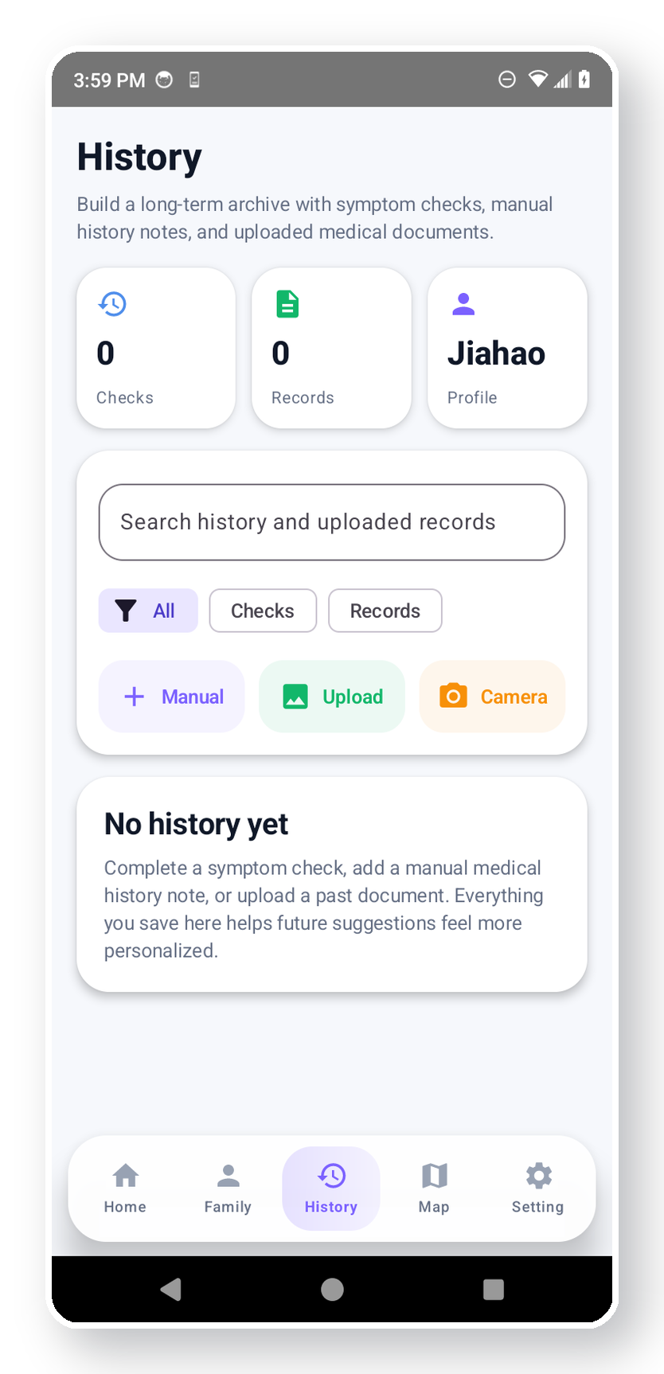
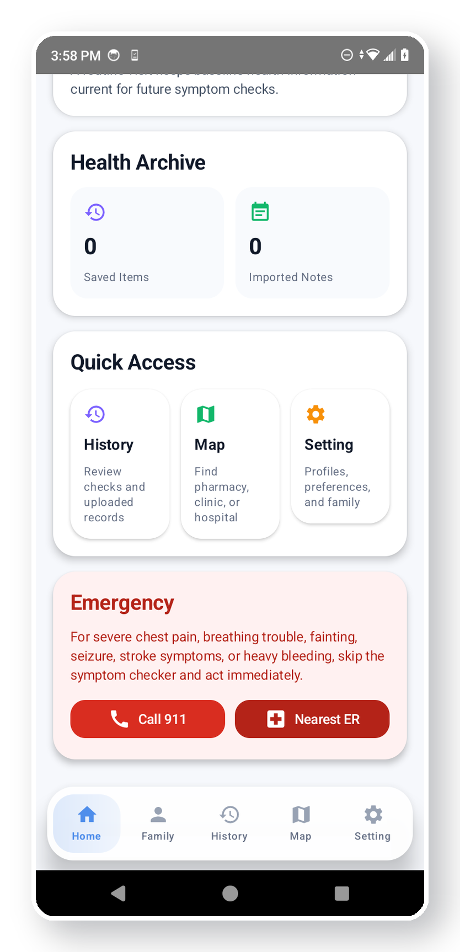
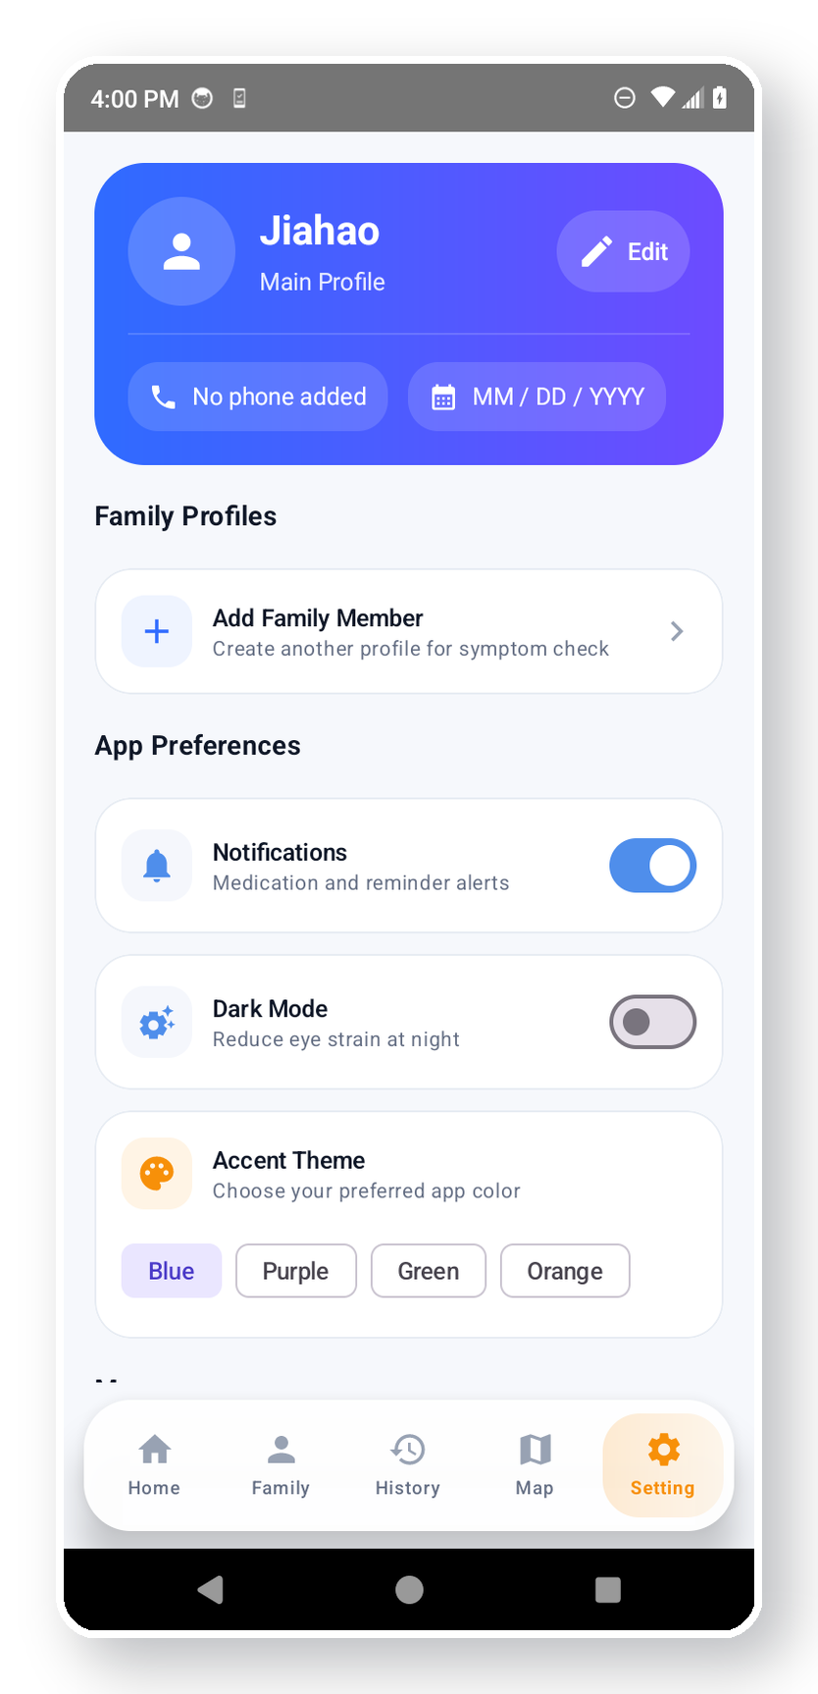
Architecture Diagram: Database Schemas + Persistence
Room handles structured local records, DataStore keeps preferences, and Firebase supports remote family sharing.
Local Room schema
SelfProfile
name, age, sex, conditions
FamilyMember
id, name, relation, profile
DataStore
Firebase
• selected patient
• dark mode
• accent theme
• Auth account
• remote family hub
• cloud sharing path
SavedCheckRecord
symptom, pain, questions, assessment
ImportedMedicalRecord
image/manual note, summary
AppSettings
dark mode, notifications, accent theme
DailyHealthTip
person id, content, timestamp
CheckupSuggestion
person id, due date, reason
Entity mappers keep DB models separated from UI models.
History
Profile
Settings
Persistence evidence: profile, family, records, history, and app settings survive screen changes and app restart.
CareRoute · CS501
database schema
05

Slide 6
Feature List
Ready in demo
Implemented / integration-ready
Progress / descoped
Home dashboard
Map search
Remote sync
hero actions, tips, emergency access
embedded map + near-me query
Fix the family hub
3D symptom check
Settings + profile
Point adjustment for the 3D body model
model, hotspots, pain slider
theme, selected patient, preferences
Have the App work without WIFI connection
Follow-up + assessment
Family Hub
Gemini-backed with fallback
remote family data started
History archive
Camera / gallery
saved checks and imported records
medical record upload path
CareRoute · CS501
feature status
06

Slide 7
Debugging & Testing Strategy
1
Build + compile checks
2
Manual flow tests
3
Integration tests
4
Safety + edge cases
• Run Gradle build after module changes
• Fix imports, route params, Room entity issues
• Keep UI code compiling before adding features
• Home → Body3D → Detail → Follow-up → Assessment
• Save assessment and verify History updates
• Switch settings and verify preference persistence
• Gemini request + fallback behavior
• Firebase auth/family data behavior
• Map query opens relevant near-me search
• Emergency mode does not enter wrong account
• Empty API output still shows safe content
• Permissions fail gracefully for voice/camera/location
CareRoute · CS501
testing
07

Slide 8
Repository Organization, Commits, and Code Quality
Repo structure
Commit evidence
app/src/main/java/...
├─ data/
│ ├─ CareRouteViewModel.kt
│ ├─ AuthViewModel.kt
│ ├─ GeminiRepository.kt
│ └─ local/ Room entities + DAO
├─ data/remote/ Firebase repositories
├─ navigation/ AppNav.kt
├─ network/ GeminiApiService.kt
├─ ui/ Compose screens
└─ ui/theme/ Material theme
• Visible commits by each member
• Bug fixes, UI updates, database work, API work
Code quality signals
• MVVM separation and repositories
• Coroutines with viewModelScope / Dispatchers.IO
• Fallbacks for API and runtime failure paths
Documentation to add
• README feature status table
• docs/ARCHITECTURE.md and docs/TESTING.md
• docs/AI_USAGE.md with examples and limitations
CareRoute · CS501
repository quality
08

Slide 9
GitHub Repository Updates
README.md
project overview, demo flow, feature status, setup steps, screenshots
docs/ARCHITECTURE.md
MVVM diagram, dependencies, state flow, navigation flow, database schema
docs/TESTING.md
debugging log, manual test matrix, integration tests, known issues
docs/AI_USAGE.md
tools used, where/how used, prompts, limits, corrections, final understanding
docs/CONTRIBUTIONS.md
team workflow, ownership, commits, integration responsibilities
CareRoute · CS501
GitHub updates
09

Slide 10
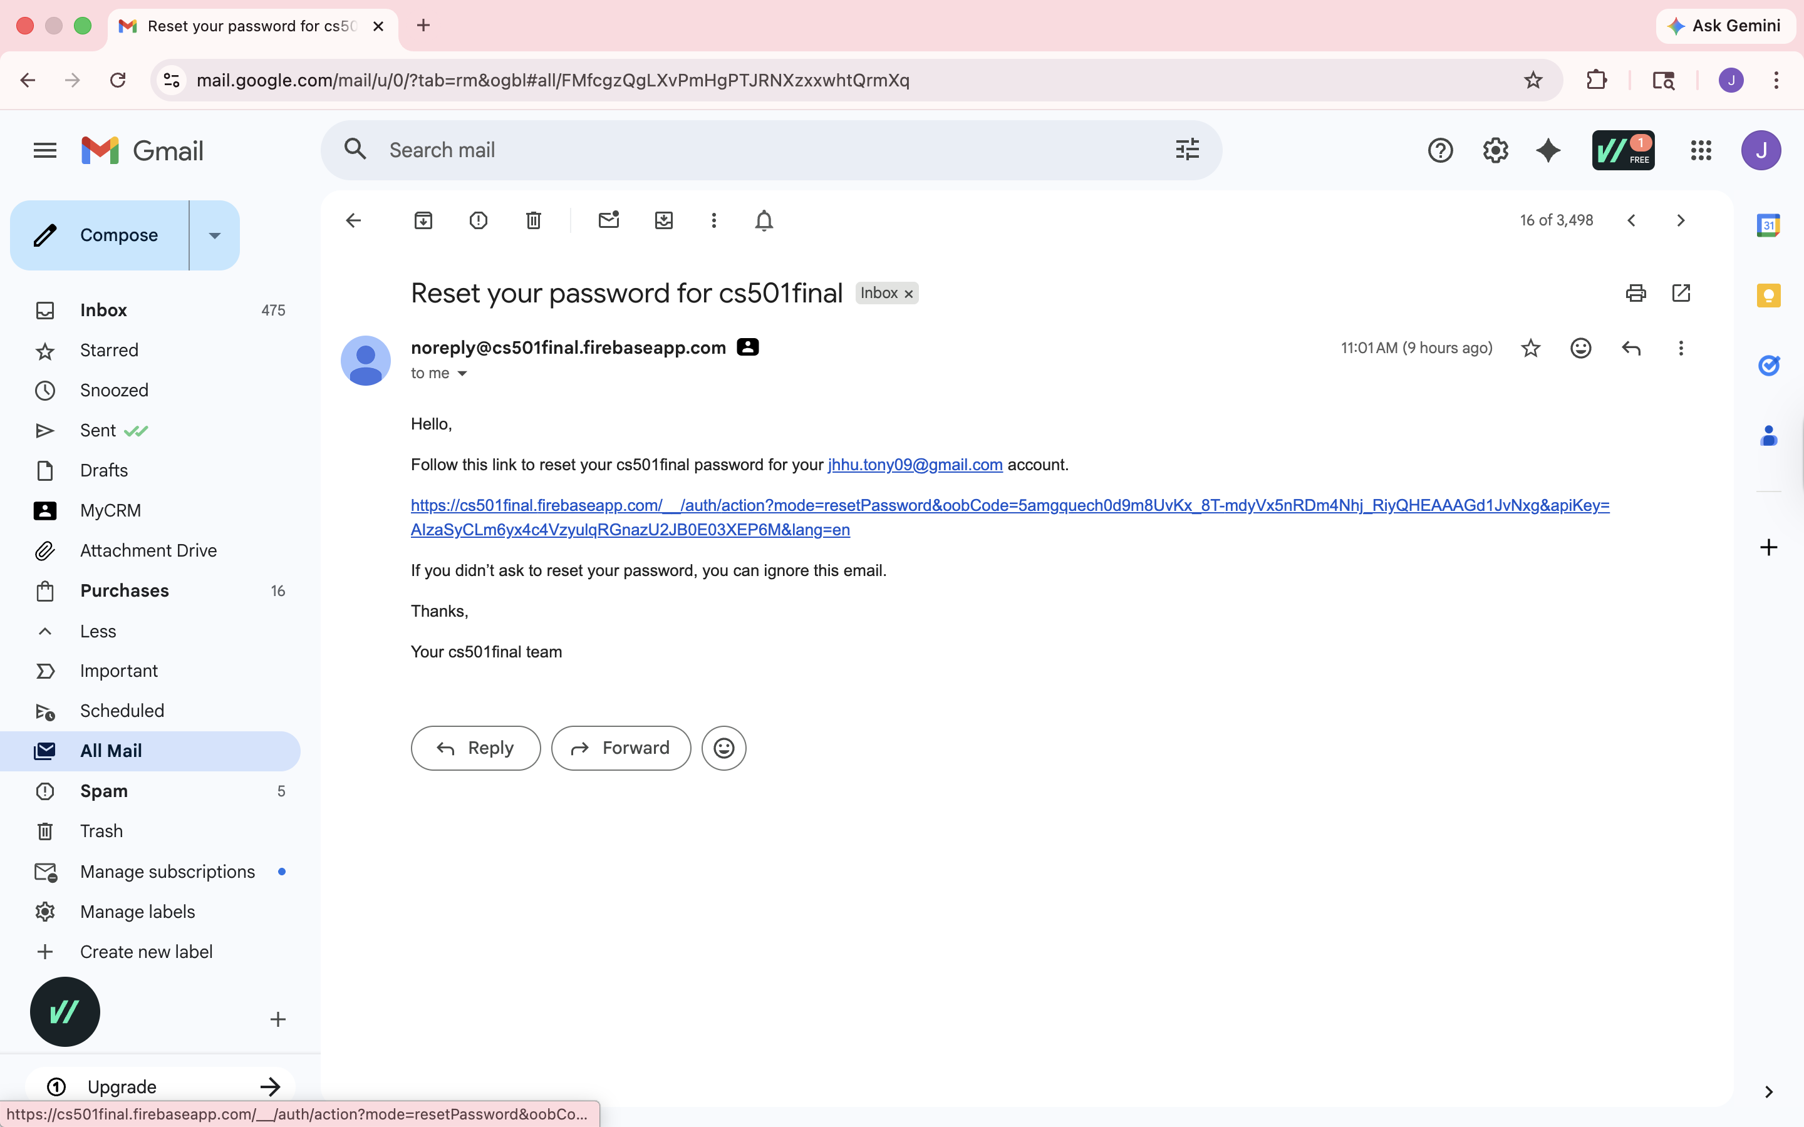
CareRoute · CS501

Slide 11
Team Workflow Breakdown
Work was split by ownership area, then merged into the final demo path and cleaned up through debugging.
Z
Zhi Gao
J
Jiahao Hu
W
Wenhao Wang
Architecture · local data · docs
Remote DB · auth · API/input
3D body · map visuals · UI polish
Built
Built
Built
• Home / History / Map / Setting navigation
• ViewModel, Room, DataStore, local records
• README/presentation cleanup and final integration
• Firebase remote database for Sign in / Family Hub
• Gemini and Google Map API feature work and voice input
• password reset + view password
• 3D body model screen
• map screen updates for nearby care
Fixed
Fixed
Fixed
• History compile/import issues
• navigation parameter mismatch
• merge cleanup and demo story
• local/remote database behavior
• emergency mode account bug
• sign-in flow polish
• body position and overlay problems
• visual shadows and final 3D polish
• map UI balance
CareRoute · CS501
team workflow
10

Slide 12
AI Usage Statement: Tools, Workflow, and Prompts
AI supported development and communication, but final code, safety decisions, and testing were handled by the team.
Ask GPT
Team filter
Implement + test
debug ideas · UI wording · README
choose what fits · reject unsafe wording
edit real files · run build · fix errors
GPT during development
How the team used it
Used for explaining Compose / ViewModel / Room / Firebase errors, brainstorming UI wording, README sections, presentation phrasing, and possible professor questions.
AI output was treated as a draft. We reviewed wording, changed code to fit our project, compiled it, tested flows, and kept fallback text for failure cases.
Example prompt: "Why does this Compose screen not update after a Room Flow change? Explain the likely causes step by step."
Example prompt: "Rewrite this assessment so it avoids diagnosis, dosage, and overconfident medical language."
CareRoute · CS501
AI usage
12

Slide 13
AI Usage Statement: Helpfulness, Limits, Corrections
What helped
Limitations we saw
Corrections we made
• Faster debugging direction
• Clearer explanations of framework errors
• Better README and slide wording
• More edge cases to test
• Sometimes suggested code did not fit our files
• Could hallucinate APIs or imports
• Medical wording could be too strong
• Layout suggestions still needed manual testing
• Compiled and edited every code change
• Removed diagnosis / dosage language
• Added safe fallback responses
• Kept API keys outside GitHub
• Tested emergency and account behavior
CareRoute · CS501
AI analysis
13

